Slide 1
General announcements
1.)

Slide 2
Imagine yourself on a distant planet…
You’re on some unknown distant planet, and you’re told that a particular object (let’s say, an alien pineapple) held 2 m above the ground will have a force of 95 N on it.
This would be useful…if everything you owned and interacted with had exactly the same mass as the alien pineapple. Otherwise, it tells you nothing about the gravitational force on any object with a different mass.
However, if you knew the force per unit mass (N/kg) for anything at the 2 m height above the ground, that would be WAY more useful.
  Hey wait. F/m = acceleration. So that gives us “g” !
2.)

Slide 3
Force “fields”
Gravitational force produced by a mass (e.g. a planet) produces a field around that object
  Knowing something about how that force affects a given amount of mass at any point around it helps define that field → acceleration!
Electric fields are quite similar!
  Let’s say we have a charge Q
  A small test charge q is placed near it.
    We could calculate the specific force exerted on q by Q using Coulomb’s law, but that would only tell us about that particular combination.
    If we could calculate the electric force PER unit charge, though, we could then apply that knowledge to ANY positive test charge q put in the same location.
3.)
http://physics.bu.edu/~duffy/PY106/Electricfield.html

Slide 4
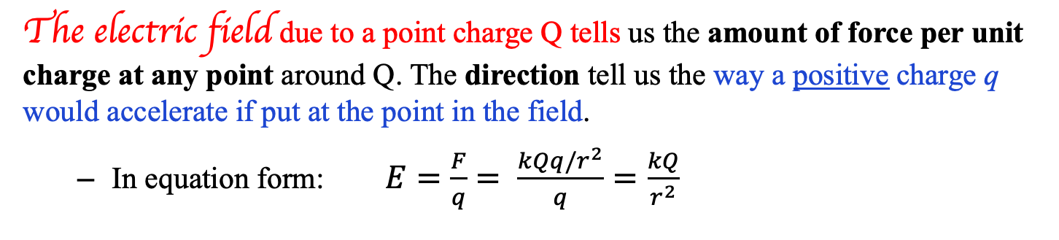
Electric Field
The electric field due to a point charge Q tells us the amount of force per unit charge at any point around Q. The direction tell us the way a positive charge q would accelerate if put at the point in the field.
  In equation form: $E=\frac{F}{q}= \frac{kQq/r^{2}}{q}=\frac{kQ}{r^{2}}$
We represent the electric field with field lines around a point charge:
  Lines point radially in or out from the charge, with arrows that point the direction a positive test charge would go
  More lines radiating from charge = stronger Q
http://physics.bu.edu/~duffy/PY106/Electricfield.html
4.)

Slide 5
Important notes about electric fields
The electric field depends only on the charge producing the field -- the test charge has nothing to do with it! The field exists regardless of whether a test charge is present, what that test charge is, etc.
Field lines emanate from a + source charge or infinity; they terminate on a - source charge or infinity. The field is strongest where the lines are closest together (nearest the source).
If you count the number of field lines originating/ending on a charge, you can qualitatively compare its strength to another charge (see next slide).
5.)

Slide 6
Subtleties Concerning Electric Fields
An electric field, being a modified force field, is a vector. So how is its direction defined?
The direction of an electric field is defined as the direction a POSITIVE TEST CHARGE will accelerate if released in the field at the point of interest.
DON’T GET AHEAD OF YOURSELF on this. You will see how it all plays out shortly. For now, just take in the definition.
Example 4: At point a designated in each of the scenarios below, draw the direction of the electric field generated by the field-producing charge configuration.
surface charge on outside
edge of hollow, insulating
sphere
direction
of E.fld
direction
of E.fld
direction
of E.fld
no E.fld
6.)

Slide 7
Electric field lines examples
Given the charges Q1 and Q2 and the electric field lines drawn, identify:
--Which charge is of greater magnitude?
--The sign on each charge?
--In which location a-e the field is strongest?
Q1 > Q2 (more lines)
Q1 is positive, Q2 is negative
e - lines are closest together (and it’s closest to a charge)
7.)

Slide 8
(next five pictures courtesy of Mr. White)
8.)

Slide 9
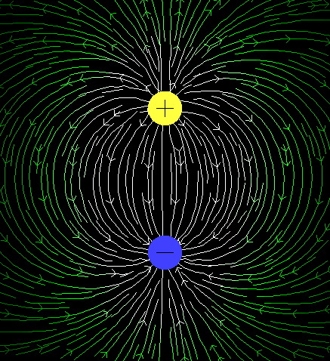
(courtesy of Mr. White)
9)

Slide 10
10.)

Slide 11
11.)

Slide 12
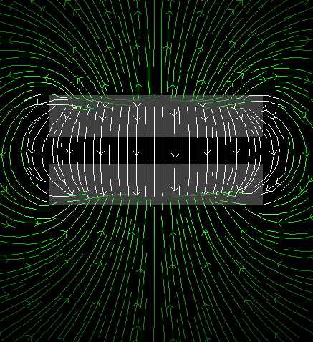
(courtesy of Mr. White)
12.)

Slide 13
(next five pictures courtesy of Mr. White)
13.)

Slide 14
14.)

Slide 15
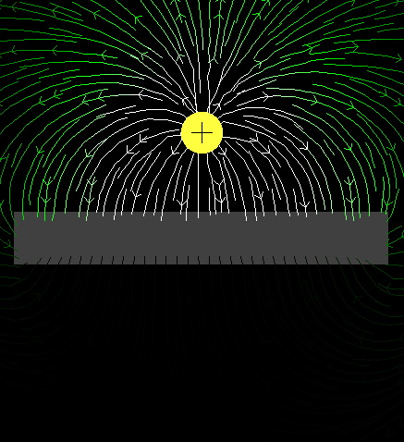
(courtesy of Mr. White)
15.)

Slide 16
16.)

Slide 17
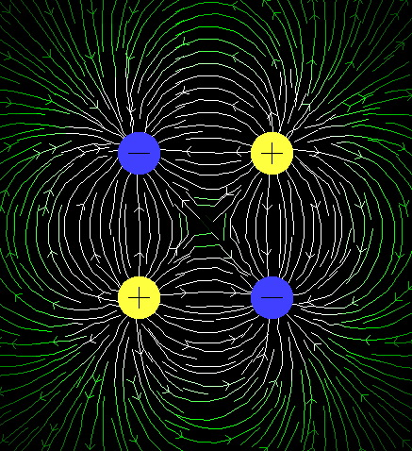
(courtesy of Mr. White)
17.)

Slide 18
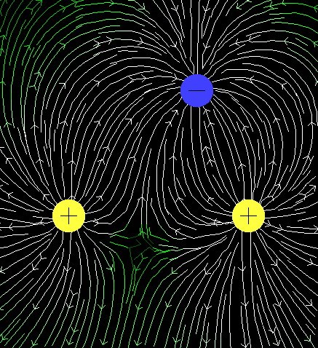
(courtesy of Mr. White)
18.)

Slide 19
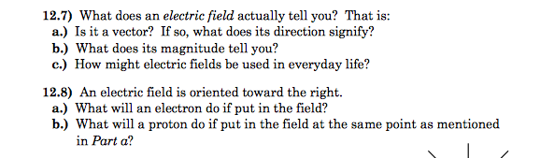
Electric Fields - concept check
From Fletch’s book
it’s a vector, which tells you the direction a positive test charge will accelerate if placed in the field (a negative charge would go the other way).
Its magnitude is the available force per unit charge (like “g”). If you place a charge “q” at any location where you know E, you can calculate the force on the charge to be F = qE (like F_{g} = mg)
This is how all our electrical devices work! When you flip a switch, plug something in, whatever, an electric field is the thing that makes electrical devices function.
An electron would accelerate to the left because the field indicates how a positive charge would accelerate.
A proton would accelerate to the right. It would feel the same electrical force as the electron (just in the opposite direction) but would accelerate differently due to its larger mass.
19.)

Slide 20
Electric field example - 15.17
A 3.8 gram mass with charge -18 𝝁C on it is suspended motionless in an electric field. Determine the electric field.
20.)

Slide 21
Electric field example - 15.17 solution
A 3.8 gram mass with charge -18 𝝁C on it is suspended motionless in an electric field. Determine the electric field.
As for direction, negative charges feel a force opposite the direction of electric fields, so if the force is up the electric field must be down and:
or
21.)

Slide 22
Electric field - FBD practice (15.21)
A block of mass m has charge -Q on it. It sits stationary on a frictionless incline. Derive an expression for the electric field to make this happen, including its direction.
22.)

Slide 23

15.21 solution
Summing the forces along the incline (and calling up the incline the +x direction):
With the ELECTRIC FORCE up the incline, and remembering that negative charges feel FORCES OPPOSITE the direction of electric fields, the field must be DOWN the incline. If the +x direction is up the incline, we can write:
$$E=−\left(\frac{mgsinθ}{Q}\right)\hat{i}$$
23.)

Slide 24
Multiple charge example
Remember that electric fields, like electric forces, are vectors! Vector addition still applies here…
Charge q₁ = 7 𝝁C is at the origin, and charge q₂ = -5 𝝁C is on the x-axis, 0.300 m from the origin.
  Find the magnitude and direction of the electric field at point P, which has coordinates (0, 0.400 m).
  Find the force on a charge of 0.2 nC placed at P.
P
0.400 m
0.500 m
+
0.300 m
-
q₁ = 7 𝝁C
q₂ = -5 𝝁C
24.)

Slide 25
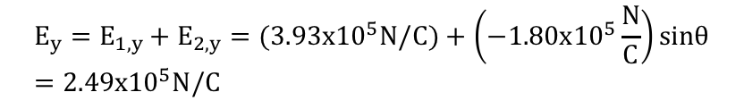



Multiple charge example
First, find the magnitude of the electric field due to each charge at P:
$$E_{1}=k_{e}\frac{q_{1}}{r^{2}}=\left(9x{10}^{9} N∙\frac{m^{2}}{C^{2}}\right)\frac{7x{10}^{−6}C}{{\left(0.4 m\right)}^{2}}=3.93x{10}^{5} N/C$$
$$E_{2}=k_{e}\frac{q_{2}}{r^{2}}=\left(9x{10}^{9} N∙\frac{m^{2}}{C^{2}}\right)\frac{5x{10}^{−6}C}{{\left(0.5 m\right)}^{2}}=1.80x{10}^{5} N/C$$
On the diagram, draw the electric field vectors at point P.
E₁
We need to add these vectors and find the resultant, so we need x and y components:
P
𝛉
$$cosθ=\frac{0.3}{0.5}=0.6$$
$$sinθ=\frac{0.4}{0.5}=0.8$$
E₂
0.400 m
0.500 m
$$E_{x}=E_{1,x}+E_{2,x}=0+\left(1.80x{10}^{5}\frac{N}{C}\right)cosθ=1.08x{10}^{5}N/C$$
$$E_{y}=E_{1,y}+E_{2,y}=(3.93x{10}^{5}N/C)+\left(−1.80x{10}^{5}\frac{N}{C}\right)sinθ=2.49x{10}^{5}N/C$$
𝛉
+
0.300 m
-
q₁ = 7 𝝁C
q₂ = -5 𝝁C
25.)

Slide 26


Multiple charge example
Now, we can find the resultant magnitude:
$$E=\sqrt{E_{x}^{2}+E_{y}^{2}}=2.71x{10}^{5}N/C$$
E₁
𝛟
𝛉
And for direction:
E₂
$$ϕ=\tan^{−1}\left(\frac{E_{y}}{E_{x}}\right)=66.6°$$
Angle above the horizontal at point P
For the force on a charge of 0.2 nC at point P:
$$E=\frac{F}{q} so F=qE=\left(0.2x{10}^{−9} C\right)\left(2.71x{10}^{5}\frac{N}{C}\right)=5.42x{10}^{−3 }N$$
Because this charge is positive, its direction will be the same as E
26.)

Slide 27
Problem 15.52 (modified)
A small plastic ball of m = 2.0 g is suspended by a string of length L = 20 cm in a uniform electric field as shown. If the ball is in equilibrium when the string makes a 15º angle with the vertical, what is the net charge on the ball?
E = 1.00 x 10³ N/C
𝛉
27.)

